Slide 1
Java Programming
Variables, If-Else Statements

Slide 2
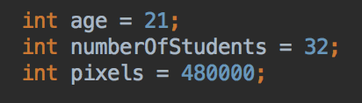
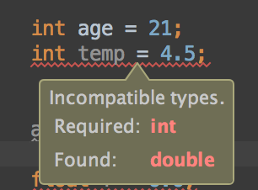
Primitive Variable Types - Integers
int = integer (whole) numbers only
Compile error if you try and store a number with decimal places in an int variable
IntelliJ's code parser will pick this up and highlight with red squiggle underline

Slide 3
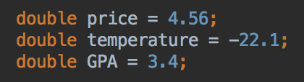
Primitive Variable Types - Doubles
double: double-precision floating point number
Java's default floating-point type.
Stores numbers with decimal places e.g. 123.456
Why the name double? There's another floating-point type called float. double variables can use twice as many bytes to store a number than float; so can store much larger values.

Slide 4
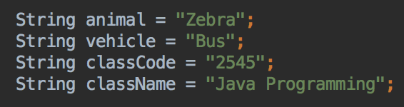
Object Variable Types - Strings
String = text data. String data (aka String literals) need to be in double quotes
Notice String has an uppercase "S"

Slide 5
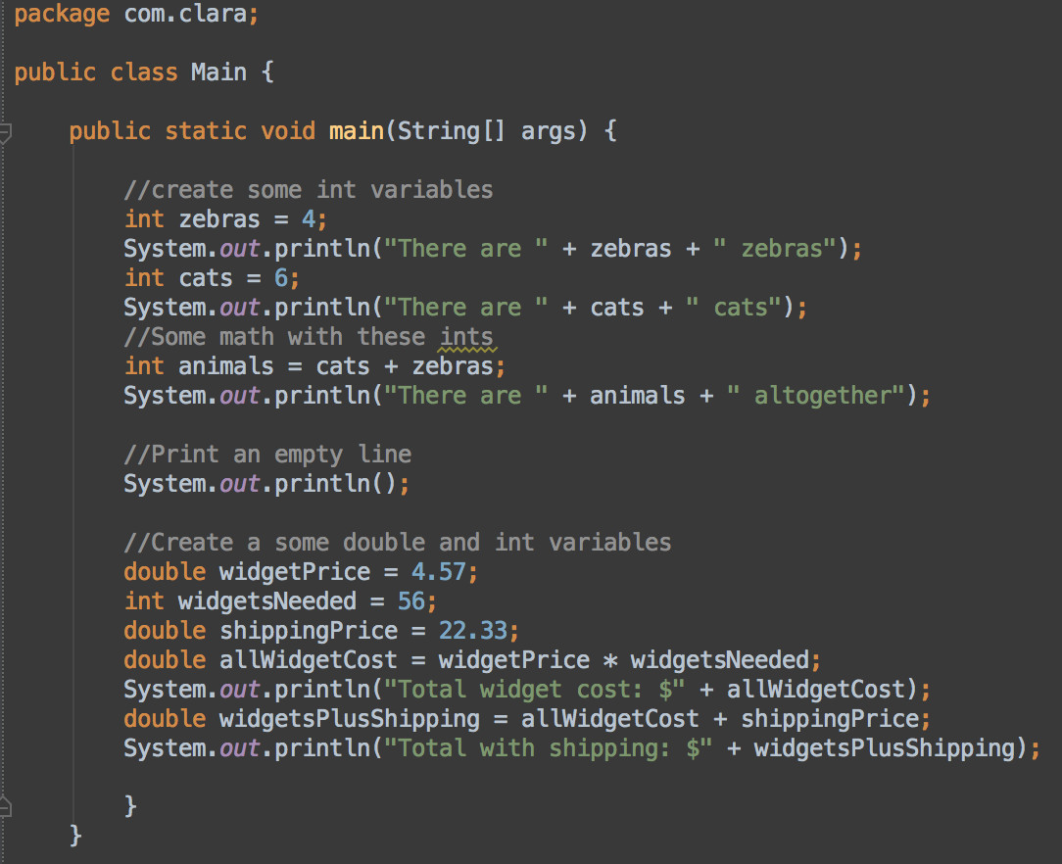
Numeric variables: int and double
int is for whole numbers
double is for whole numbers or numbers with decimal places

Slide 6
Primitive Variable Types: Booleans
A boolean variable can store one of two values: true or false
Useful in conditional statements
boolean allDone = false;
boolean easyMode = true;
if (allDone) {
System.out.println("Great!");
}

Slide 7
User Input
Gather user input from the console
Not quite as straightforward as Python :(
We'll use a helper library called input-utils
IntelliJ can use Maven to fetch this code for us
Maven: a Java build tool and dependency management; fetch 3rd party libraries and make them available to your project

Slide 8
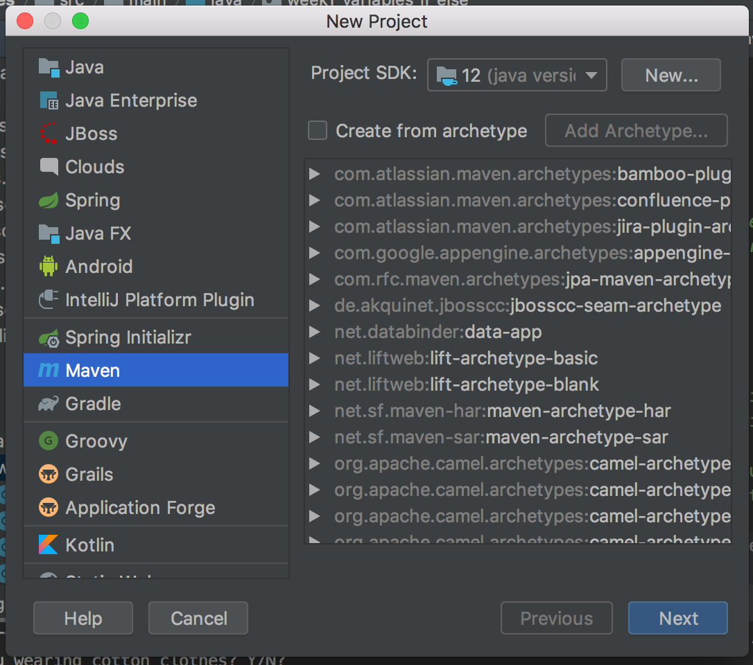
Create New Project
Select Maven as the type, Project SDK should be Java 12, click Next
Select Maven here

Slide 9
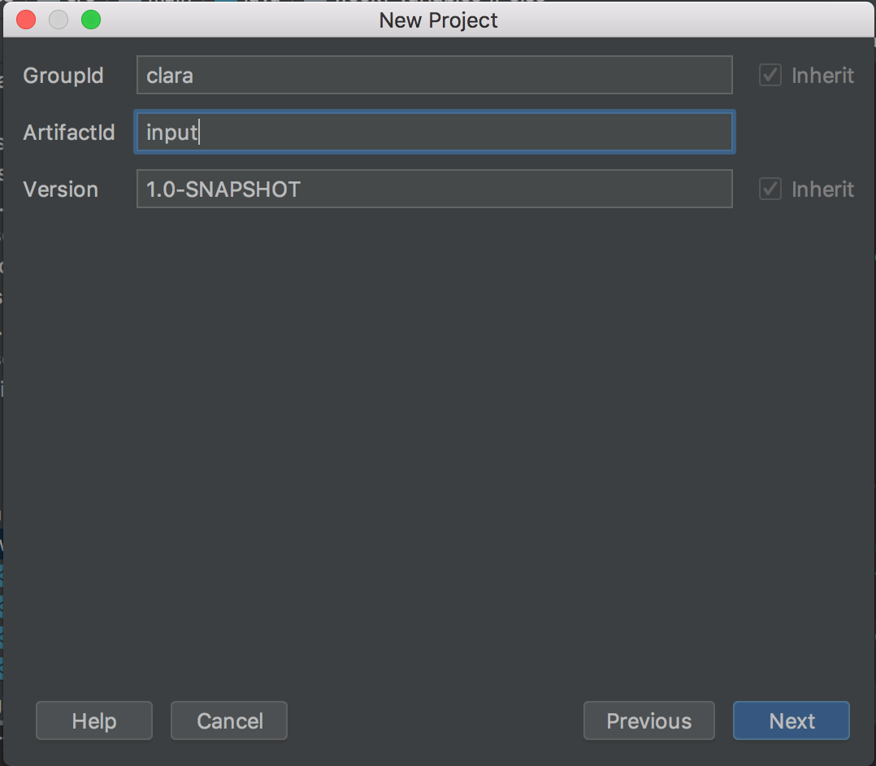
New Project
GroupID = your name and ArtifactID = input
Specific name is not important for this project
Values should be all one word, no spaces
Click next

Slide 10
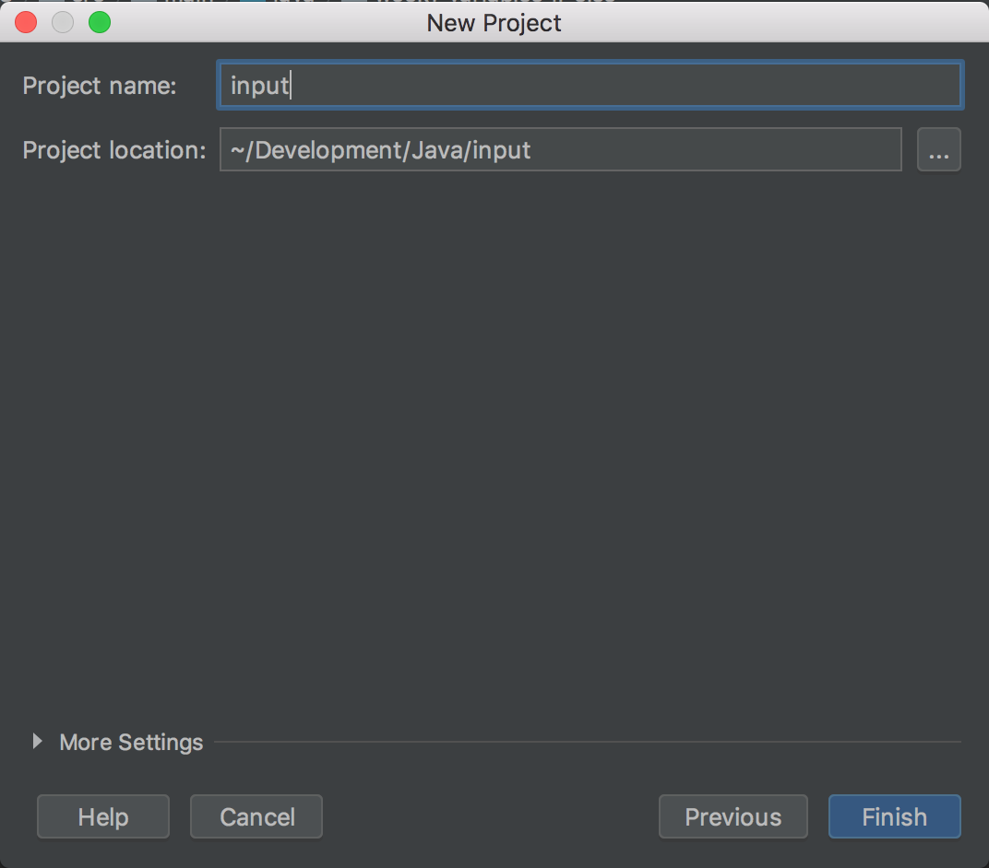
Project name
Anything you like - I called mine input
Click Finish

Slide 11
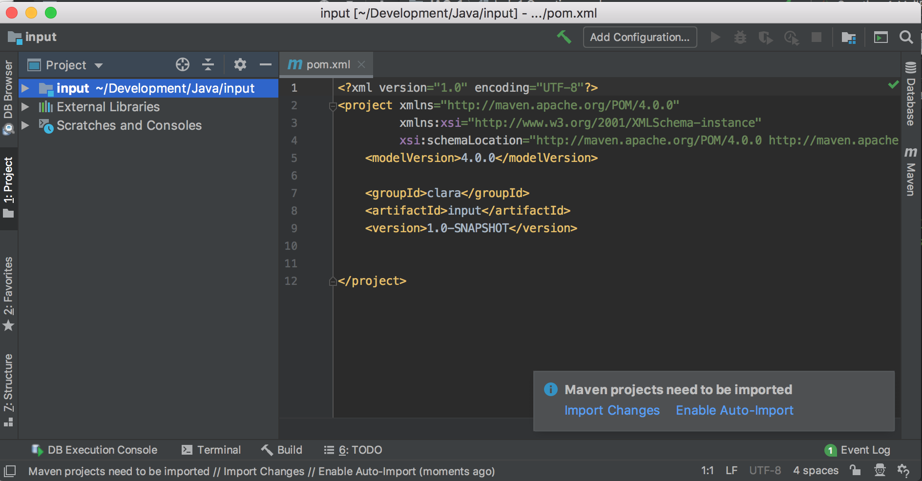
Project opens, pom.xml file
Maven is a build manager for Java projects. It can control how a project is compiled, and fetch other code that the project needs
Maven projects needs a file called pom.xml that describes the project, it's dependencies (other code it needs), and various other information

Slide 12
Examine the pom.xml
You will add the input-utils dependency to pom.xml here
Also need to specify which version of Java we are using
You will add dependency here
Before the </project> line

Slide 13
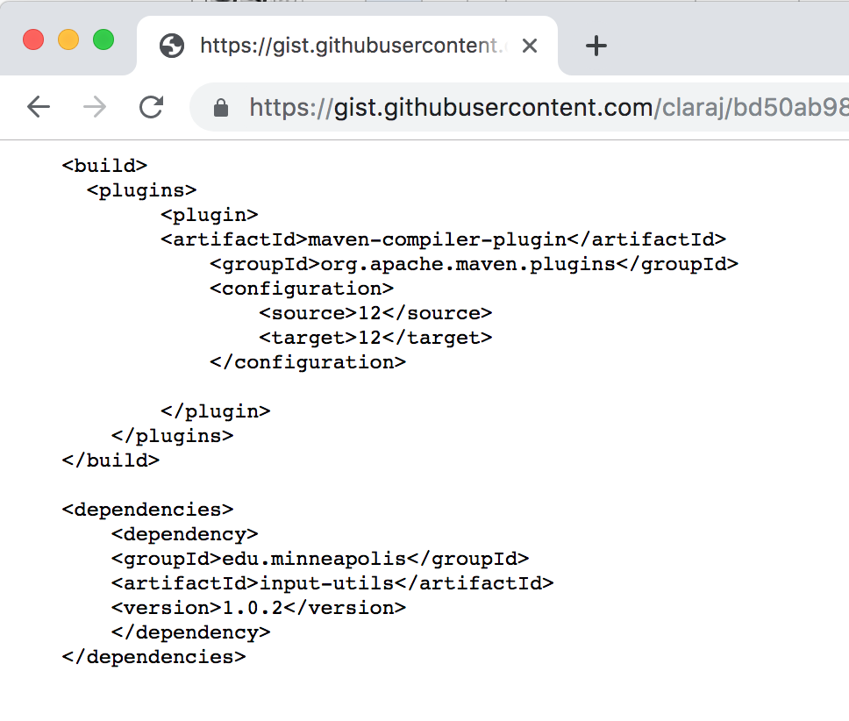
Go to this link
https://git.io/fj5ZS
This tells Maven what version of Java to use, and where to find and download the input-utils dependency
Copy all of the text on this page

Slide 14
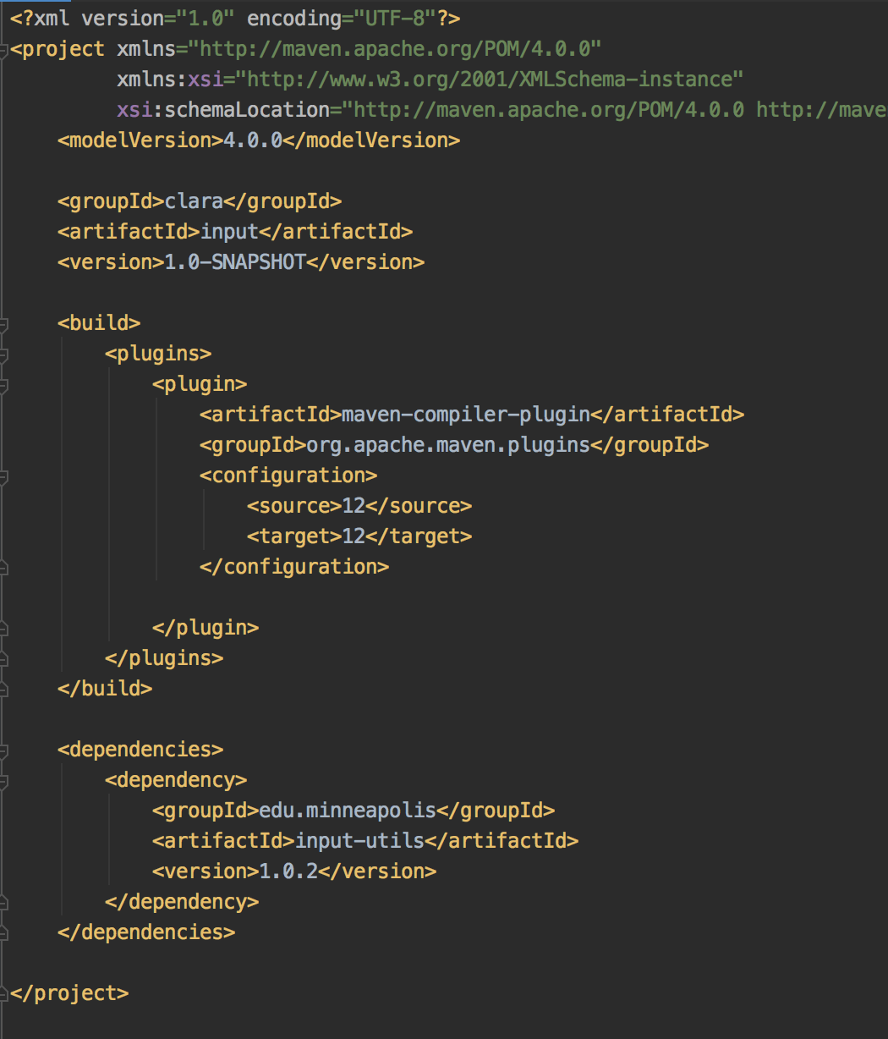
Paste the text from the previous page into your pom.xml Your pom.xml file should look like this
This is the part you pasted from the web page

Slide 15
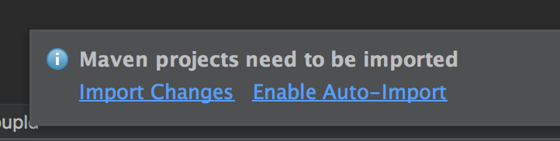
Import changes
Click on Import Changes link
Your project can now use the the input-utils library

Slide 16
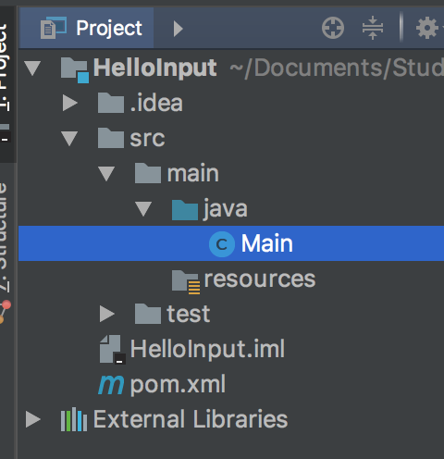
Create Java File
Expand src/main/java
Right-click on java directory
Select New > Java Class
Call the new class Main

Slide 17
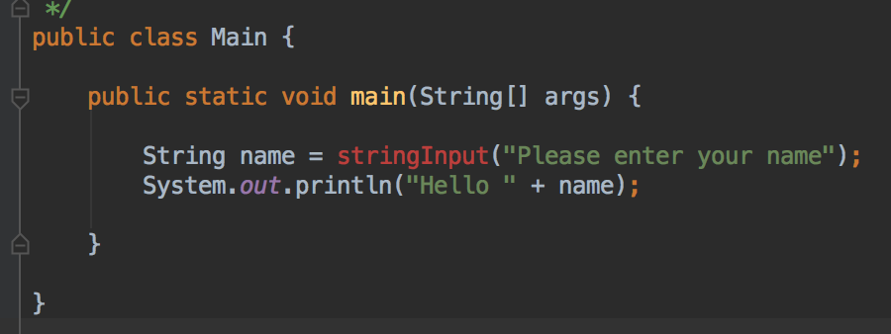
Type this code
Remember the psvm shortcut for creating the main method?
Uh oh - the stringInput line is red, indicating an error

Slide 18
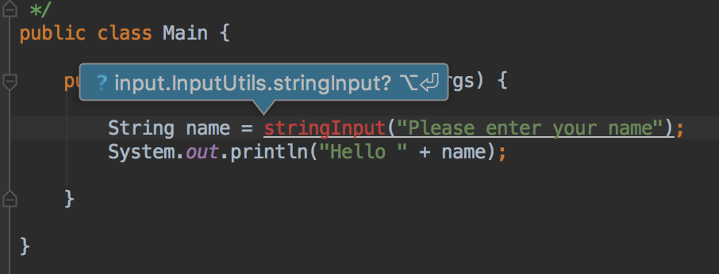
Adding stringInput to this class
Put the cursor on stringInput
PC: press Alt + Enter
Mac: press Option + Enter

Slide 19
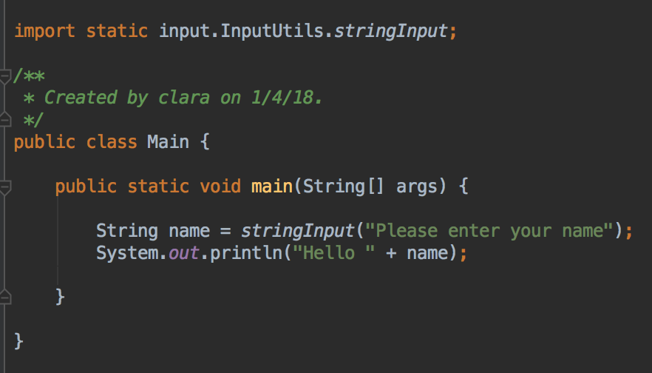
Main.java
Import the stringInput method from the InputUtils library
Should now look like this
Prints the string argument
Waits for user input
Returns whatever the user types;
which is stored in the variable name

Slide 20
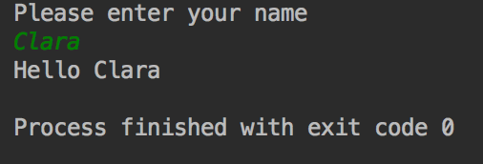
Run and test
Right-click on your code, or the Java file, and select Run
Enter your name when prompted
Expected output should look something like this:

Slide 21
InputUtils method examples
String name = stringInput("What is your name?");
int candyBars = intInput("How many candy bars?");
// As above, but checks number is positive
int people = positiveIntInput("How many people?");
double price = doubleInput("What is the price of the item?");
// As above but checks number is positive
double length = positiveDoubleInput("How long is the string?");
// User can type "y" or "n" or "yes" or "no"
boolean ok = yesNoInput("OK to continue?");
//The question is optional, so you can also write code like this,
System.out.println("What is your name?");
String data = stringInput()

Slide 22
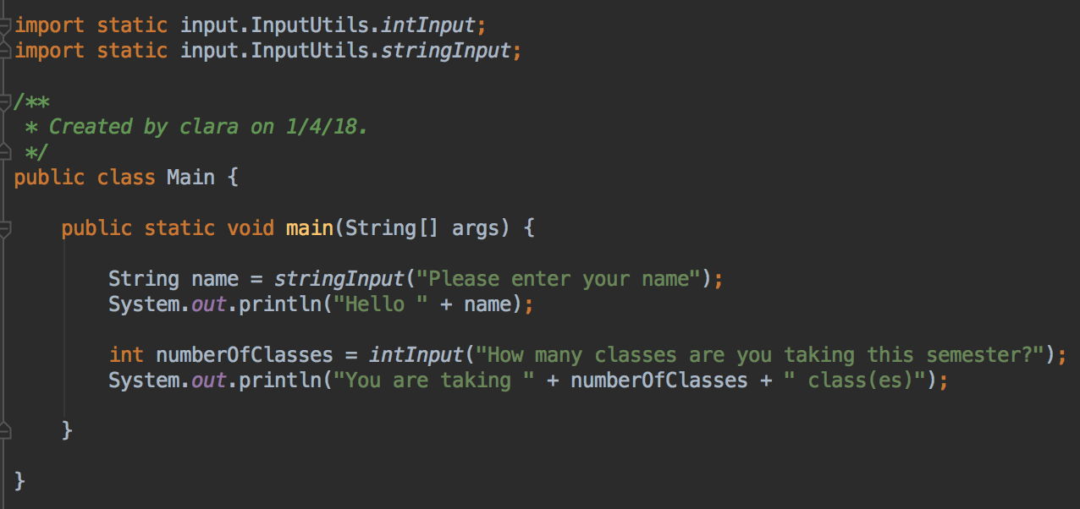
Get some number input
Add code to this program to ask for the number of classes you have this semester
Alt+Enter or Option+Enter to import intInput method

Slide 23
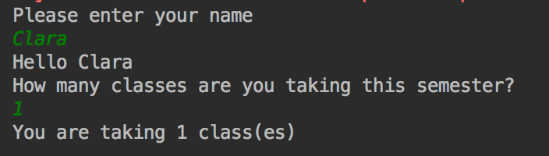
Run and test
Example output

Slide 24
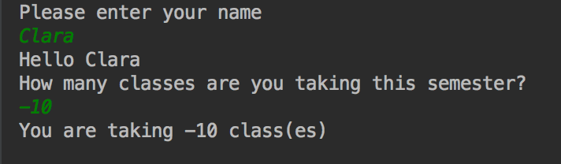
Run and test again – try a negative number
That doesn't make sense…

Slide 25
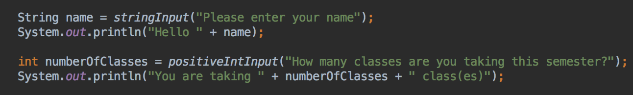
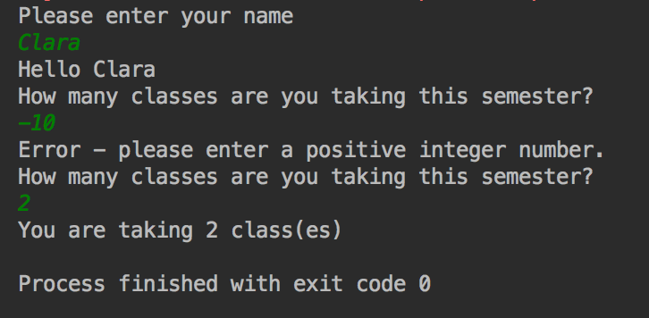
Replace intInput with positiveIntInput
Run and test, and try a negative number
Program doesn't accept negative numbers, only 0 or greater are acceptable

Slide 26
Class(es)
That looks messy.
Can we modify the program to print "class" for one class, or "classes" otherwise?
e.g.
"You are taking 1 class"
or
"You are taking 3 classes"

Slide 27
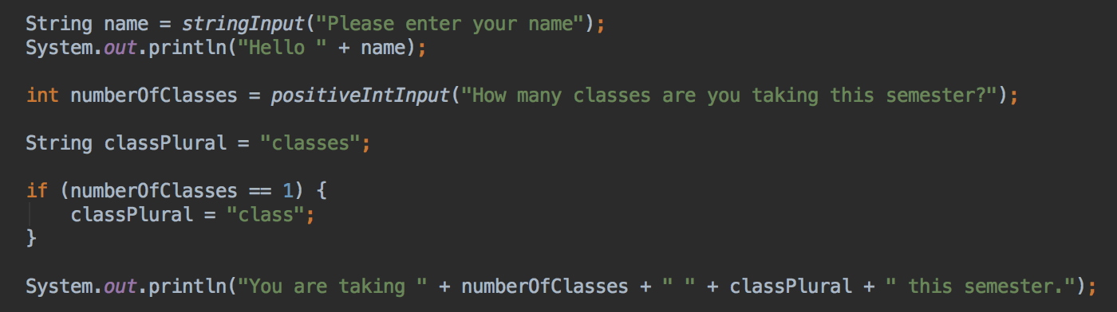
Add an if statement
Check if numberOfClasses == 1
Run and test with 1 class, with 0 classes, with more than 1 classes; verify correct output

Slide 28
Reading Numbers and Strings
Let's write a program to figure out the total sale price for a product
The user should be able to enter the name of the produce (for example, a packet of spaghetti)
The user should enter the price of one item (for example, one packet of spaghetti costs $1.20)
And the quantity of that product to sell (for example, 3 packets of spaghetti)
The program should calculate the total price and display this price

Slide 29
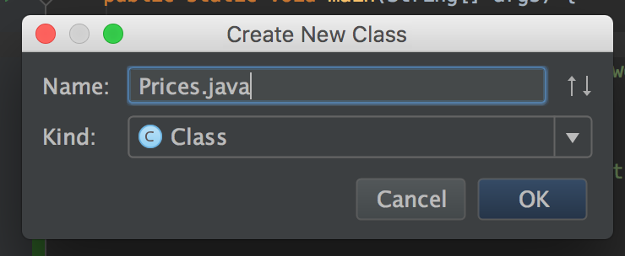
Setup
In the same project, create a new Java class
Call it Prices.java
Create a main method

Slide 30
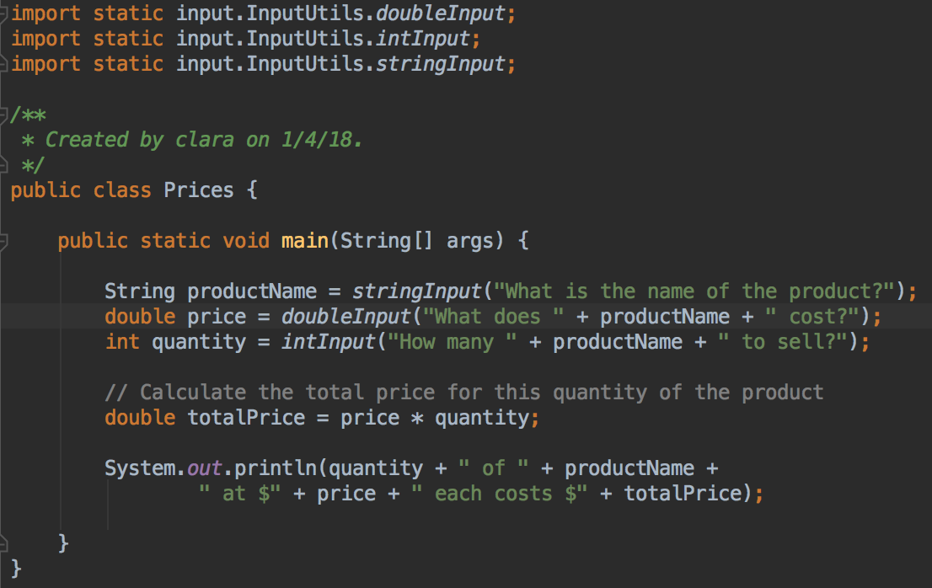
Code for Prices.java

Slide 31
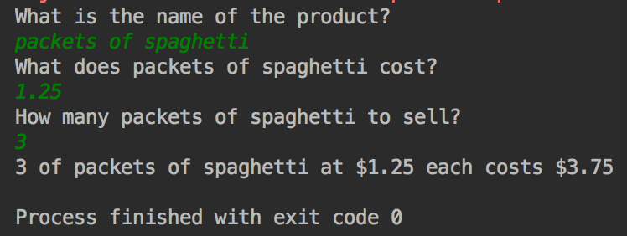
Run and test
Try with example product, and price and quantity, and verify it's working
Notice you don't need to add the $ sign in front of the price when you type it in
What happens if you do?

Slide 32
Your Turn
In the same project, create a new Java class and add a main method, as before
In your main method, ask the user for the distance between their house and MCTC, in miles
Use the doubleInput method
Your program should convert this distance to kilometers, and display the distance in kilometers
To convert miles to kilometers: multiply by 1.6
Actually the conversion factor is 1.60934… but 1.6 will be fine here, approx. values are OK in this problem.

Slide 33
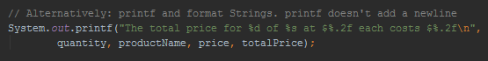
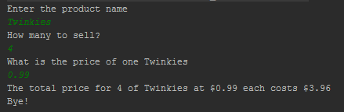
Optional: rounding and displaying double numbers to fixed number of decimal places
Option 1: ignore, it's the right answer as long as you get the correct number when rounded to a sensible number of decimal places
Option 2, if it bothers you: use System.out.printf formatting to display doubles to a particular number of decimal places, for example
Option 3: Look up Java's currency formatting library
Example output ->

Slide 34
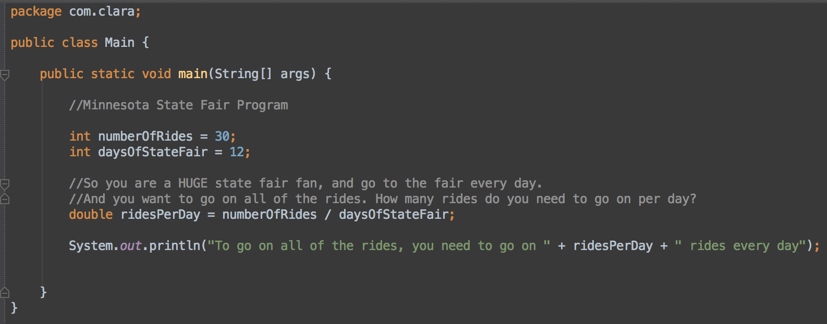
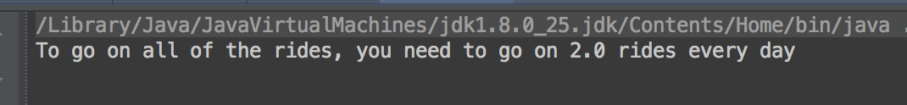
int and double math
Look at look at the output from this program
What's wrong?

Slide 35
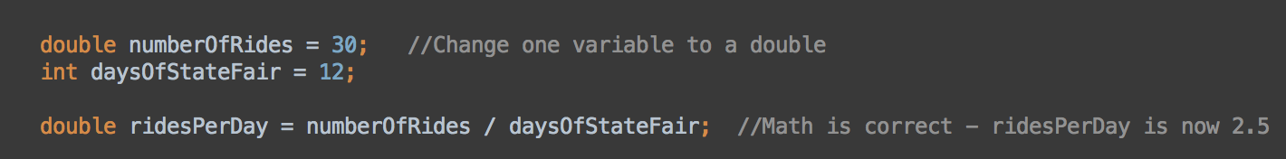
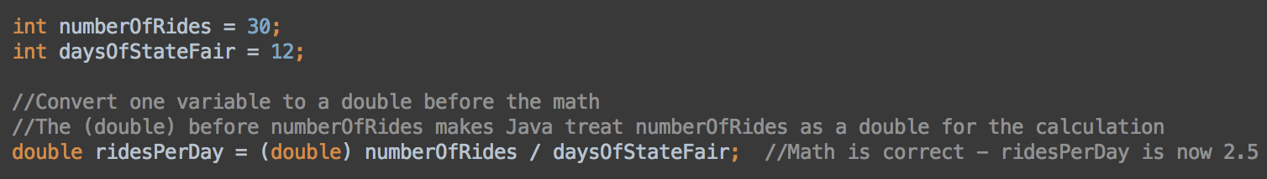
Math with int variables
You'll always get an int result! Even if the answer 'should' be a floating point number, Java will round down to the nearest int
Be aware of this if you do division with int variables that can possibly result in a double answer
To fix, make either one, or both of the int variables a double
Or convert (cast) one variable to a double before you do the math
Always verify and check the math your programs do!

Slide 36
If statements

Slide 37
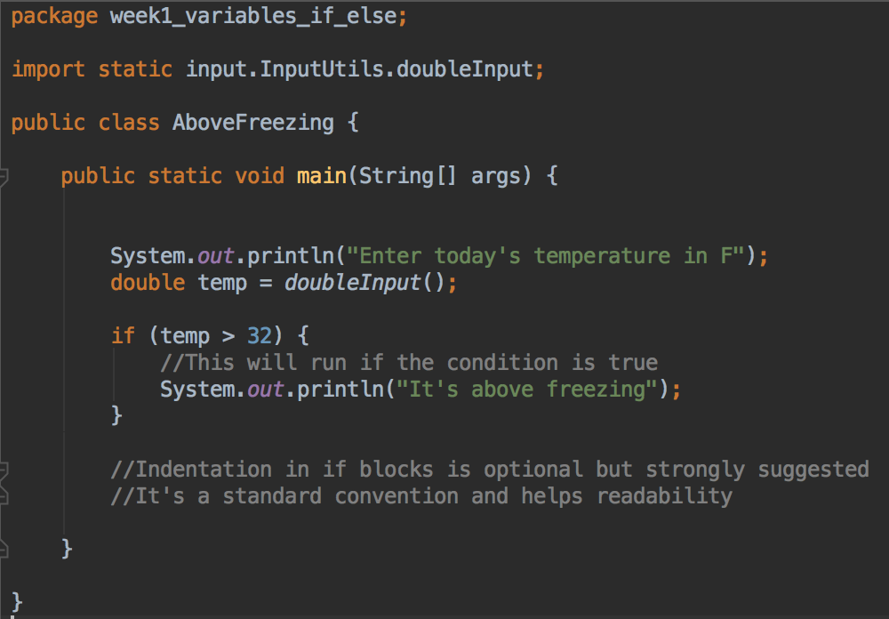
If statements
Used to evaluate a condition for truth; and take action based on result
Example:
test if a
variable, temp,
is greater
than 32, and
print a message
if so

Slide 38
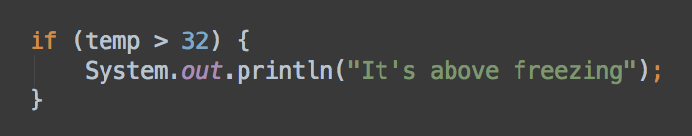
if statements syntax
There are round brackets/parenthesis () around the condition - the part that will evaluate to true or false. In this example (temp > 32)
Also curly brackets { } around conditional code
The curly brackets enclose the code that will only run IF the condition is true
So if temp <= 32 then this program won't print "It's above freezing"

Slide 39
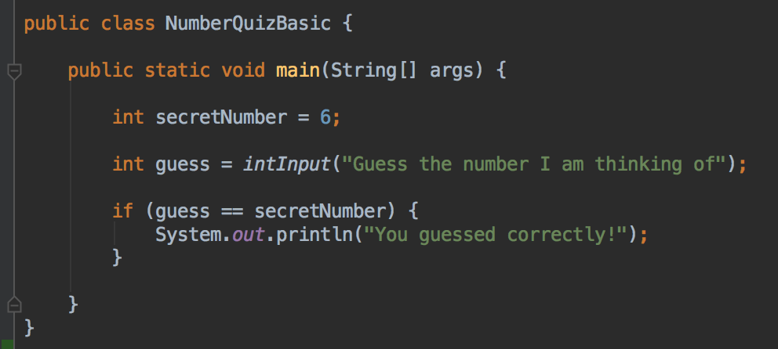
if statements example == used to test for equality
Use two equals symbols == to test if two numbers or two boolean values are equal

Slide 40
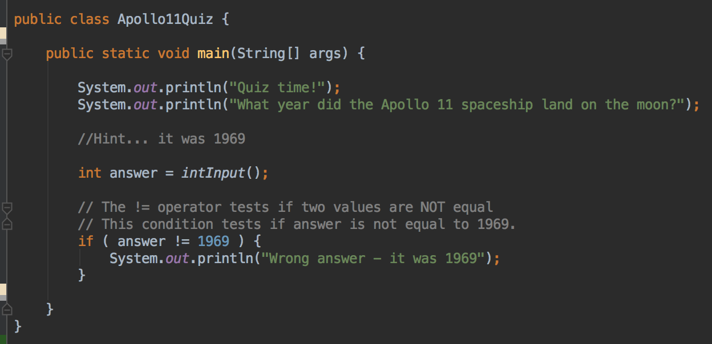
Testing if things are not equal
Use != to test if two values are not equal

Slide 41
Comparison operators
Symbol | Means
== | Equal to
> | Greater than
>= | Greater than or equal to
< | Less than
<= | Less than or equal to
!= | Not equals

Slide 42
Your turn
Start with your miles to MCTC program
Once the user has typed in their response, test to see if the user lives more than 10 miles away
Use an if statement to display "You live more than 10 miles from MCTC" if they live more than 10 miles away

Slide 43
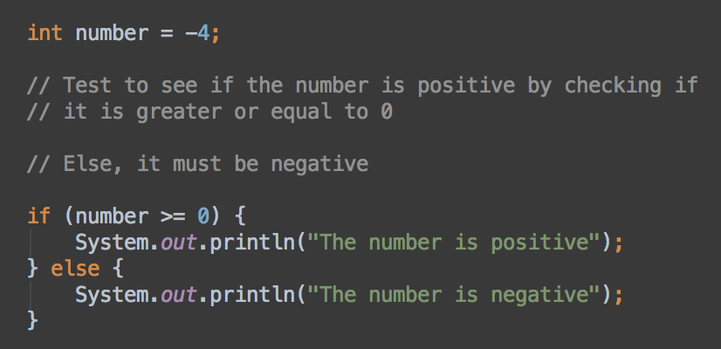
if - else
Often it's helpful to do one thing if a condition is true, and something else if it's false
Add an else statement immediately after the if statement
Note the else comes right after the close curly bracket for the if statement
The code to run if the condition is false goes in the curly brackets after else
This code runs if the condition is true
Or, this code runs if the condition is false

Slide 44
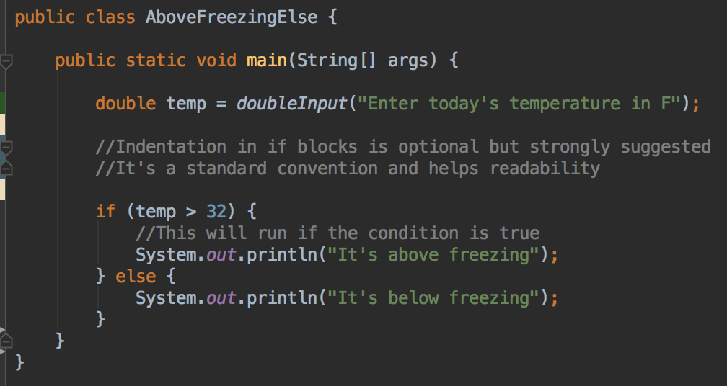
if - else
Scanner numberScanner = new Scanner(System.in);
System.out.println("Enter today's temperature in F");
double temp = numberScanner.nextDouble();
if (temp > 32) {
System.out.println("It's above freezing");
} else {
System.out.println("It's below freezing");
}
//Indentation is optional but strongly suggested
//It's a standard convention and helps readability

Slide 45
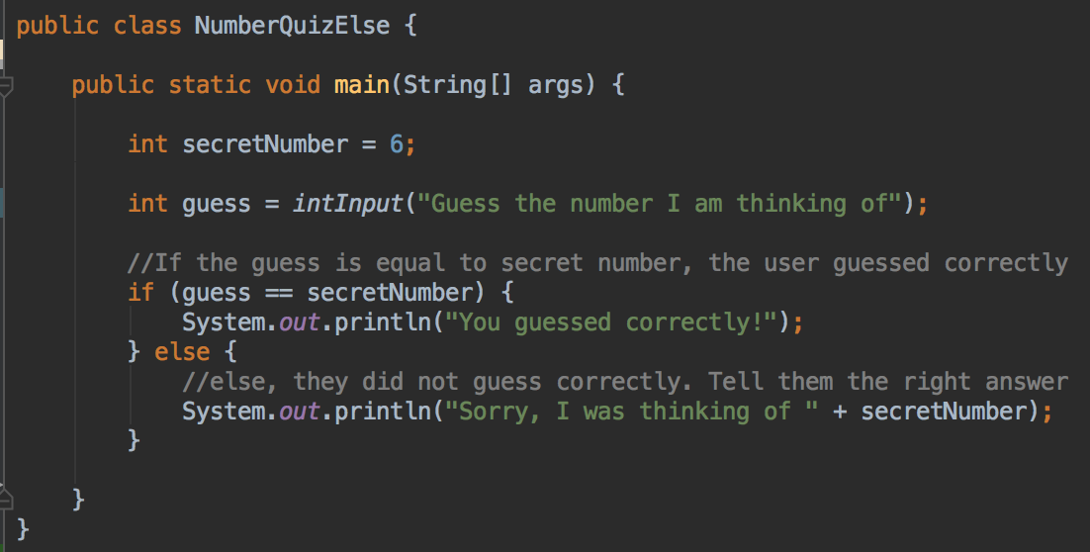
if - else

Slide 46
Your turn
Start with your miles to MCTC program
Once the user has typed in their response, display "you live more than 10 miles from MCTC" if they live more than 10 miles away
And, display "you live less than 10 miles from MCTC" if they live less than 10 miles away
Use the if-else syntax

Slide 47
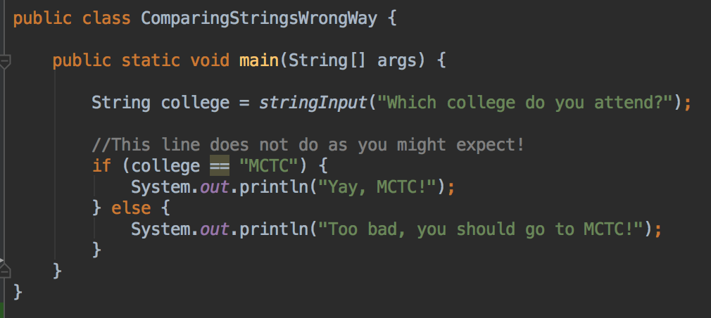
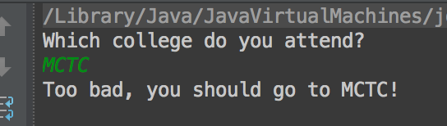
Comparing Strings
Use == to compare int, double, boolean, and other primitive type values
BUT Strings are objects, and == doesn't work as you might expect
Look at the output from this code. What's wrong? Why?

Slide 48
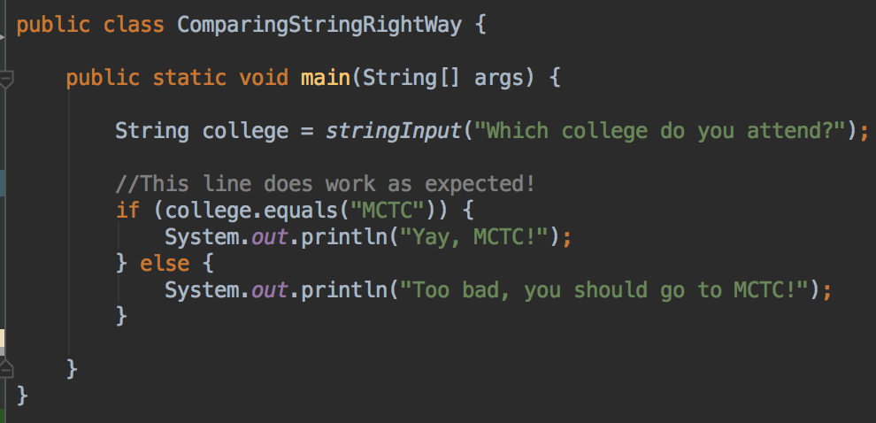
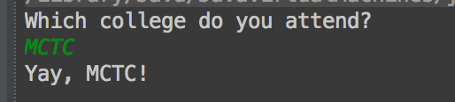
Comparing Strings Correctly
Use the .equals() method gives the expected result

Slide 49
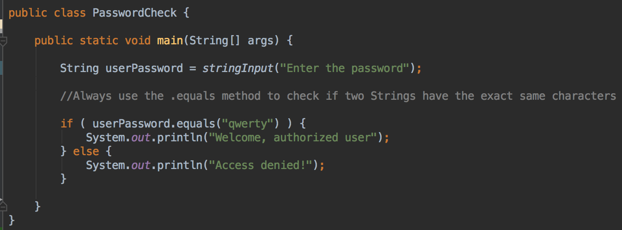
Comparing Strings with .equals()
The .equals() method test for the exact same characters in two Strings.
.equals() is case sensitive. "A" is not the same as "a"

Slide 50
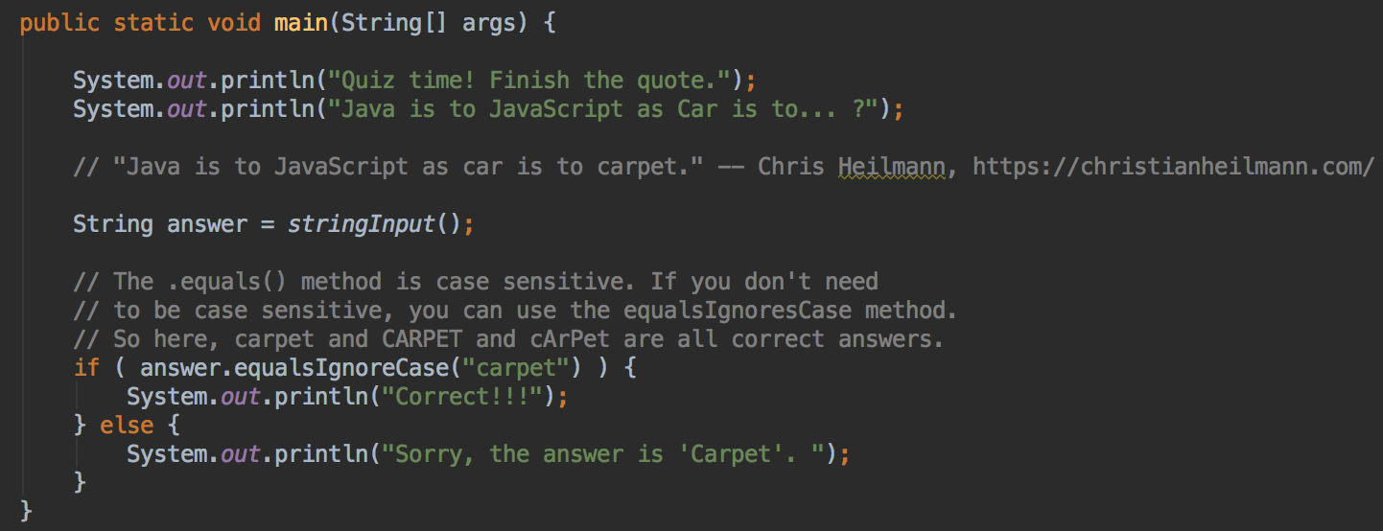
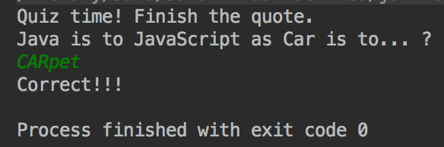
Comparing Strings
There is also an .equalsIgnoreCase() method if you don't care about case in the comparison

Slide 51
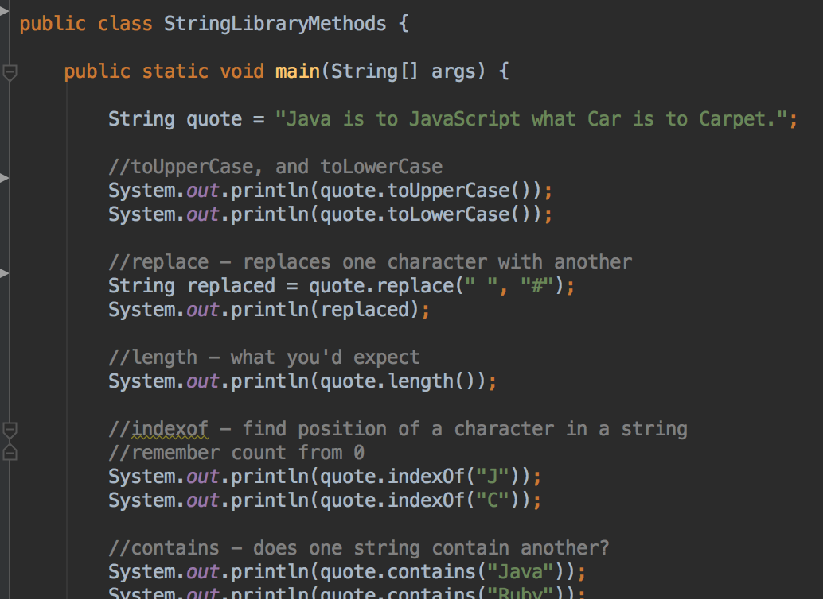
Java String Library Methods
Lots of library methods, you should get familiar with them
https://docs.oracle.com/en/java/javase/11/docs/api/java.base/java/lang/String.html
See full file in the code example repository
https://git.io/fhs1D

Slide 52
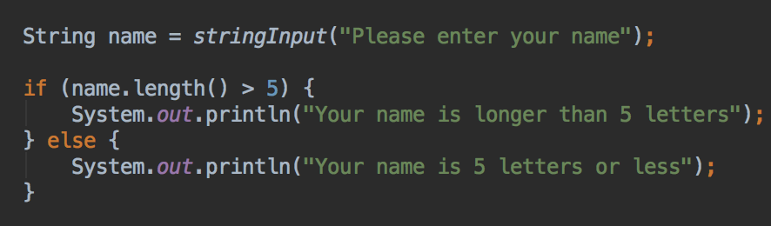
Conditions; String Library Methods

Slide 53
if – else if - else
What if you have several different things you might want to do, based on the value of the variable you are comparing?
You can add else if statements if you have 3 or more possible things that could happen
Each else if statement needs a condition to test
The else statement never needs a condition – the else code only runs if the if and all the else if conditions are false

Slide 54
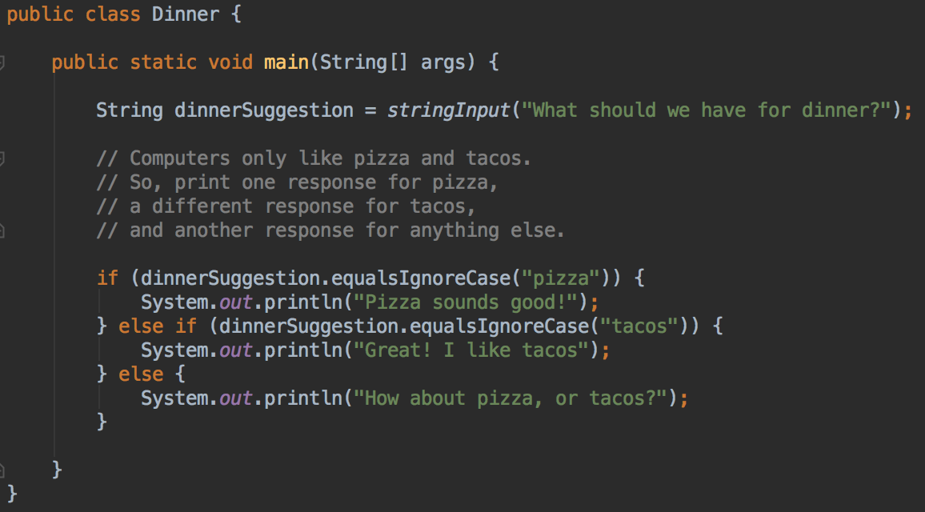
if; else if; else

Slide 55
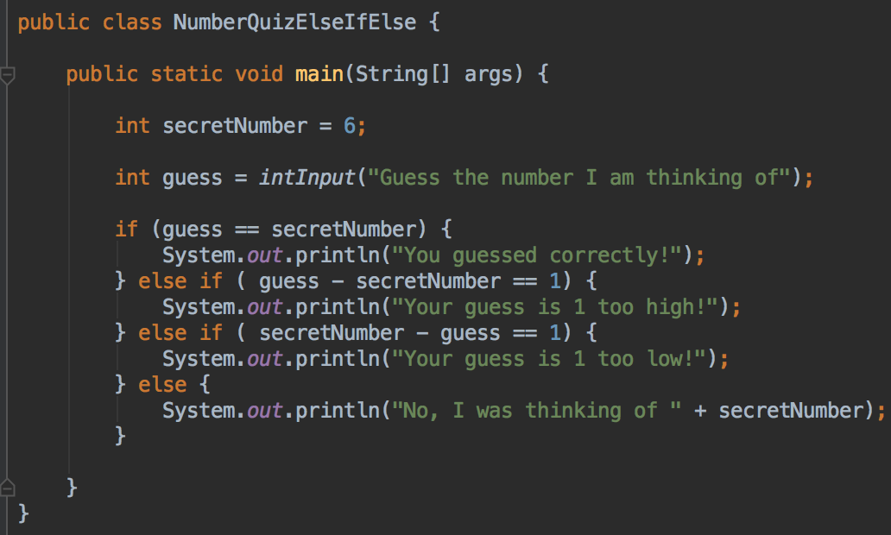
if – else if - else
You can use as many else if statements as you need

Slide 56
Your turn
Start with your miles to MCTC program
Once the user has typed in their response, display "you live more than 10 miles from MCTC" if they live more than 10 miles away
And, display "you live exactly 10 miles from MCTC" if they live exactly 10 miles away
And, display "you live less than 10 miles from MCTC" if they live less than 10 miles away
Use if – else if – else statements

Slide 57
boolean
boolean is a primitive type that stores either true or false
Can use the boolean values true and false in expressions
boolean easyMode = true;
if (easyMode == true) {
System.out.println("Here's a hint...");
}
// Or more simply, just
if (easyMode) {
System.out.println("Here's a hint...");
}

Slide 58
The boolean type
Can use the values true and false in comparisons
String sentence = "I'm a sentence";
if (sentence.endsWith(".") == false) {
System.out.println("A sentence should end with a . ");
}
// Alternatively, use !
// The ! reverses the truth of an expression
if (! sentence.endsWith(".")) {
System.out.println("A sentence should end with a . ");
}

Slide 59
AND
The symbol && is used for testing if one condition AND another condition are both true
if ( temp > 70 && rain == 0 ) {
System.out.println("Warm and no rain - a nice day!");
}

Slide 60
OR
The symbols || are used for testing if one condition OR another condition OR both are true
// test if the weather is really cold
// or the windchill is -30 or both...
if (temp < 20 || windchill < -30) {
System.out.println("Brrr, stay inside");
}
&& and || are also used in other languages, such as C and C++ and C#
| is the pipe character, it's usually the shift character for your backslash key

Slide 61

And &&
Not the complete or exact requirements for being a blood donor – http://www.bloodcenters.org/blood-donation/am-i-eligible/ - obviously this program could be refined!

Slide 62

And &&
Can check more than two things
For example, to take ITEC 1310 Microcomputer Maintenance, you must first complete all of ITEC 1100, ITEC 1100 AND ITEC 1250

Slide 63

And &&
Can combine anything that evaluates to true or false

Slide 64

Or ||
Checking pre-requisites
Can you take Android app development?
The pre-requisite for this class is completing either C# or Java

Slide 65

How to travel to school?
There's usually more than one way to write an if statement
Do you prefer the OR or the AND version?

Slide 66

Combinations of AND and OR
Take care when combining AND and OR
Know that Java evaluates statements from left to right
And in an OR statement, if the first thing is true, the whole condition is true, so there's no need to evaluate the second thing
If hasTakenCSharp is true, there's no need to check hasTakenJava because the user has already met the pre-requisites
Similar for AND statements - if the first thing is false, there's no need to check the second thing

Slide 67
Combining AND and OR
Taking welding classes at MCTC
Dress safely, in either wool or cotton clothes
Wear closed-toe shoes
Let's write a program to check if a student is dressed safely

Slide 68

Your turn
Create a new class called Welding
Create a main method with this code

Slide 69


If statement
Let's try this. It sounds good - it reads like the description of safe clothes and shoes
Run and test
Try with cottonClothes = yes
closedToeShoes = no
Is this correct?

Slide 70
What's wrong?
Java evaluates left to right
It checks cottonClothes, and sees that it is followed by an OR operator
So, if cottonClothes is true, then there is no need to check the rest of the condition.
closedToeShoes is never checked
The if statement evaluates to true

Slide 71

Fix - add parenthesis to correct the order of operations
Add parenthesis around the cottonClothes || woolClothes part of the if-statement
This makes Java evaluate the whole (cottonClothes || woolClothes) part
Java sees that it's followed by an AND && so it still need to check closedToeShoes if the first part if true
Run and test - should work correctly

Slide 72
Labs and the Autograder
You should have git installed on your computer
You should have a GitHub account
GitHub is a code hosting website. You'll use it to submit your assignments and projects

Slide 73

Lab 1
In D2L, go to Content > Labs > GitHub classroom lab links
Click on the first link, for lab 1, which is in the labs section of D2L
GitHub will create a new
repository containing some
starter code for this lab

Slide 74
Note the link at the bottom of the page
It will look something like this, https://github.com/mctc-itec/lab-1-if-else-YOUR_GITHUB_ID
Copy your version of this URL
This is a private repository, only you and I can see it
https://github.com/mctc-itec has all of your lab repositories
Let's download it to your computer… IntelliJ can do it for us

Slide 75


In IntelliJ
Open VCS menu > Checkout from version control > GitHub
You may need to sign in to GitHub
Paste the link that GitHub gave you in the GitHub repository URL field
Parent Directory, Directory name: your choice
Click Clone; code should download
Sign in with your GitHub username and password

Slide 76

Code downloads
Look for bubble that says "Maven projects need to be imported"
Click Import Changes

Slide 77

Lab files, instructions
Instructions are in grades/Lab 1 Questions.md
Code is in src/main/java/week_1/

Slide 78

Write code
Let's work on the first question,
Open Question_1_Miles_From_MCTC.java
Some code is already written for you
You'll finish the code, as marked. Look for the //TODO lines

Slide 79

Write code
Question_1_Miles_From_MCTC.java
Look for the TODO lines, highlighted in yellow or blue

Slide 80

milestoMCTC method
The input to this method is a number of miles, held in the variable miles
The output - the value returned - should be a String, describing the distance
input miles
output String. null is a special value meaning 'no data'

Slide 81
milestoMCTC method
Your task is to write code inside this method so that it does the correct task
(Reminder: generate the appropriate String, based on the number of miles, return this String)
input miles
output string. null is a special value meaning 'no data'

Slide 82

Let's try this solution
If you've written your own version, you can use that instead :)

Slide 83


Run code
Right-click in the Java file and select Run
Check that the output is correct

Slide 84


Run automatic tests
Open test/java/week_1
Right-click on Question_1_TestMilesFromMCTC
Select Run
Should see a green bar
All 2 tests passed
This question is done!

Slide 85
Repeat for the other questions
Read question
Write code
Run and check code; fix any errors
Run automatic tests, make sure all pass; fix any errors
Write comments

Slide 86

Failing tests
Right-click and run TestNASAAstronaught
Red bar, test fails
That's expected - haven't written any code yet
Once you've written the code for this, try tests again

Slide 87

Saving and submitting your code
Commit = save a snapshot of your work
Push = upload to your GitHub repository
Click the green up arrow in the IntelliJ menu bar
Or VCS menu; Git; Commit File

Slide 88

Commit and Push
Write a message in the commit message box
e.g. "Finished question 1"
Hover over Commit button
Select Commit and Push

Slide 89
Check your repository in GitHub
Your changes should be there
Commit and push as you work to save your changes to GitHub
For example, commit and push after completing each question
Commit and push when you take a break
Commit and push before leaving the lab

Slide 90
Lab time
We'll usually start the lab on Tuesday
Keep working on it on Wednesday
Finish and remaining problems before next Tuesday's class
Questions? Problems? Please ask!
Help out other students; figure out problems together
Study groups and collaboration are encouraged!

